Slide 1


Class Attendance System Based On Face Detection And Recognition
Software Group project
Presented By:
Parthiv Patel (18DCE084)
Shaunak Patel (18DCE086)
Saumya Raval (18DCE103)
Kashyap Shah (18DCE115)
Charotar University of Science and Technology
Devang Patel Institute of Adv
Technology and Research

Slide 2
OUTLINE
Introduction
Current system & problems of the system
Project definition and planning
How we will implement it
Proposed system and scope of the system
Requirements gathering and techniques used
Flowchart
Hardware and software requirements
Role

Slide 3
Introduction
As we know that the current way of manually taking attendance of each student is not efficient .
To overcome this we will implement class attendance system that uses face detection and recognition technique.
This will be a very quick way to take attendance of the class, Also chances of proxy will be zero.

Slide 4


Current system & problems of the system
Traditionally attendance is marked manually by teachers and they must make sure correct attendance is marked for respective student.
This whole process wastes some of lecture time and part of correct information is missed due to fraudulent and proxy cases.

Slide 5
Project Definition & Planning
In Face detection and recognition first of all faces are captured through a high definition camera
Then the program first detects the faces inside a given image.
After the it matches them with the photos inside our database folder and recognizes them.

Slide 6
How we will do it ?
In this project we will use python language and OpenCV (Open Source Computer Vision Library).
Here we will compare the image from webcam with image of database.
Then some details are extracted from the captured faces , which are unique and compared with the database faces.
Finally whichever face distance match is lesser means more better match.

Slide 7
Proposed System and scope of the system
The proposed system will automatically mark attendance of the students present inside the classroom at given particular time.
Whenever a we put an image as input it first detects the faces in the image.
Then it takes around 128 measurement values from each face and matches these values with the database images.
A frame of around the person is formed when it is matched with a picture from database.

Slide 8
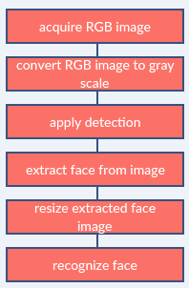
Flowchart
Acquire RCB Image
Convert RCB Image to gray scale
Apply Detection
Extract face from image
Resize extracted face image
Recognize face
Compare recognize face details with dataset
Attendance updated

Slide 9
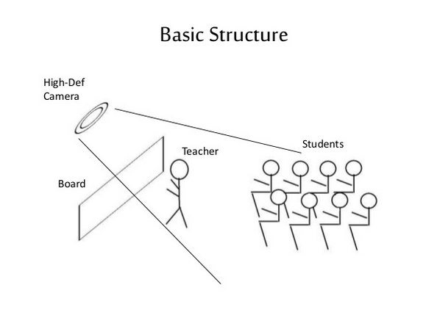

Slide 10
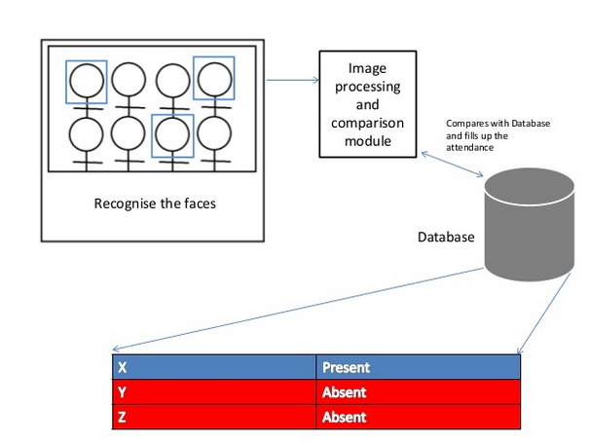

Slide 11
Hardware and software requirements
Software
Pycharm(IDE),Desktop developer for C++,
Library:
openCV
Face_detection
Numpy
Cmake
Dlib
Hardware
Min. 4gb ram Laptop/PC with Webcam

Slide 12
Role
Saumya Raval:
Installation of all libraries and setting up the IDE(i.e. Pycharm)
Shaunak Patel:
Understanding how face det. & recognition works
Parthiv Patel:
Research on image processing and labeling.
Kashyap Shah:
Simple Program to detect faces and recognize them

Slide 13
References:
https://medium.com/@ageitgey/machine-learning-is-fun-part-4-modern-face-recognition-with-deep-learning-c3cffc121d78

Slide 14
THANK YOU

Slide 15
Dlib is a modern C++ toolkit containing machine learning algorithms and tools for creating complex software in C++ to solve real world problems.
CMake is a cross-platform free and open-source software tool for managing the build process of software using a compiler-independent method.
OpenCV is the most popular library for computer vision. Originally written in C/C++, it now provides bindings for Python. OpenCV uses machine learning algorithms to search for faces within a picture. Because faces are so complicated, there isn't one simple test that will tell you if it found a face or not.
Numpy is a library for the Python programming language, adding support for large, multi-dimensional arrays and matrices, along with a large collection of high-level mathematical functions to operate on these arrays. Moreover Numpy forms the foundation of the Machine Learning stack.Dec

